Slide 1

COMPUTATIONAL FOUNDATIONS FOR ARTIFICIAL INTELLIGENCE
Project Title: Hospital bed allocation system
Section: 12
Batch: 15
2520030012 Dharmika
2520030211 Bhaarathi
2520090232 Sahithya
Under the guidance of
Dr. Ramakanth Komati
Term -3 semester 2025-2026

Slide 2
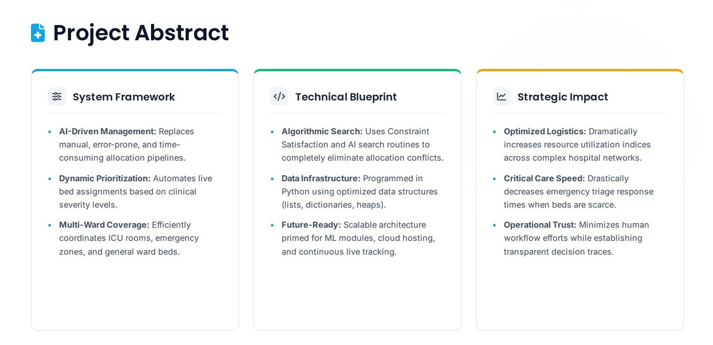

Slide 3
Technology or Concepts that are used
CO’s | Technology or Concept Used | Reason | Why it is used
CO-1 | Problem Formulation & Python Data Structures Rule-Based Logic & Constraints Trace Logging & Testing | Registration forms, validation, Python/React logic, data structures, state handling | Efficient healthcare data management Secure and accurate patient data entry Easy debugging and system testing
CO-2 | Search Algorithms Concept Heuristic & Efficient Search Concepts | Simple searching/filtering of patients resembles search concepts, but not full BFS/A* algorithms | Quick patient information retrieval Faster and efficient data access
CO-3 | CSP (Constraint Satisfaction Problems) Constraint Propagation | Appointment scheduling and validation use constraint-based logic | Prevents scheduling conflicts Manages doctor availability efficiently
CO-4 | Decision Logic Utility Functions | Decision-making exists in navigation and role access, but not actual minimax/game AI | Controls user access securely Improves healthcare management efficiency
CO-5 | Bayesian/Probability Concepts Uncertainty Handling | Probability, Bayesian networks, HMMs are generally not present unless you added prediction features | Supports smart healthcare decisions Ensures reliable system performance

Slide 4
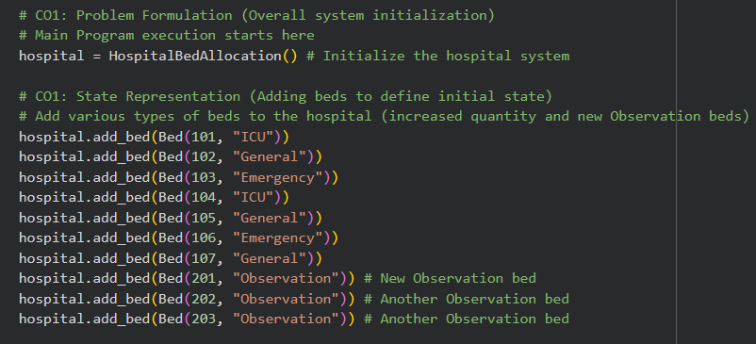
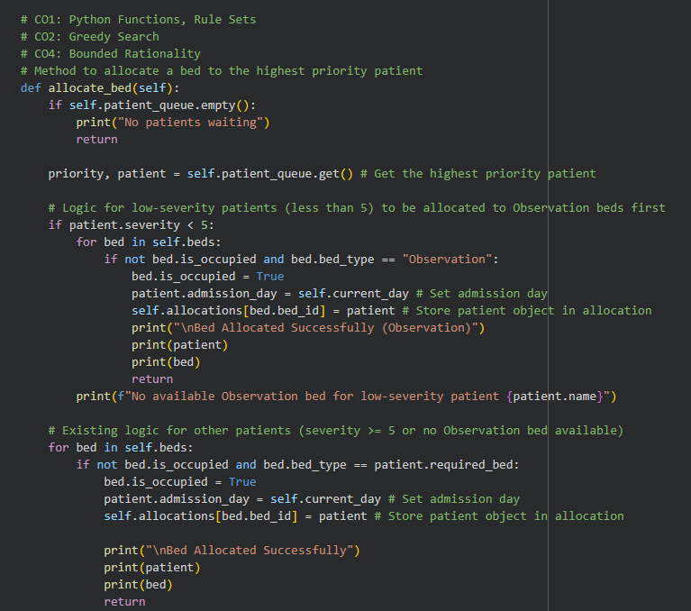
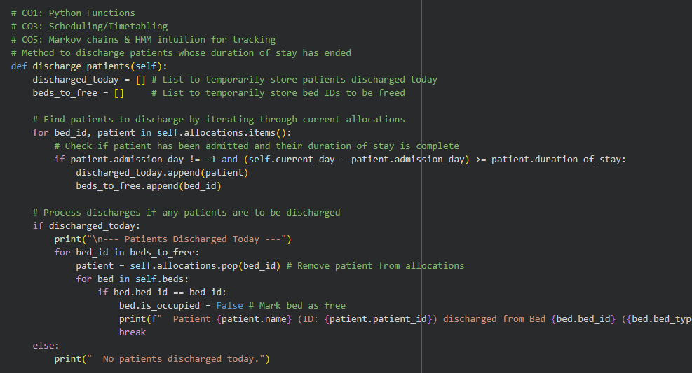
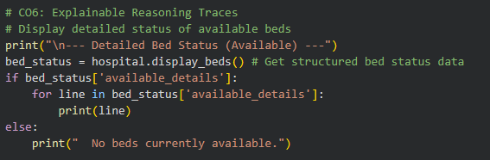
CO’s | Technology or Concept Used | Reason | Why it is used
CO-6 | Hybrid AI Architecture Explainable Reasoning & Performance Ethics & Limitations | Integration of modules, validation, security, explainability, performance handling | Integrates multiple system modules Improves user experience and maintenance Ensures secure patient data handling
CO-2,4
CO-1
CO-3,5
CO-6

Slide 5
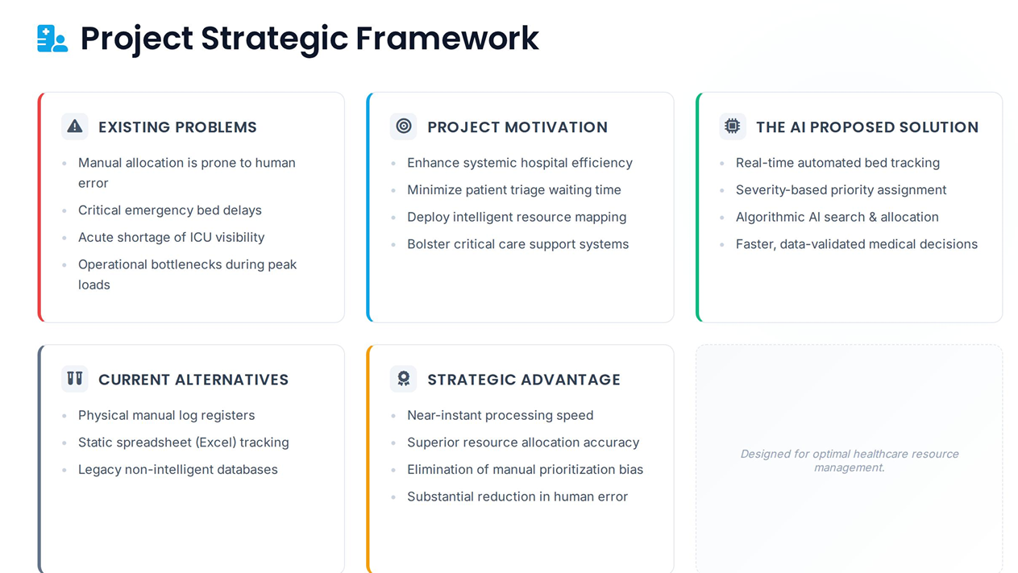

Slide 6
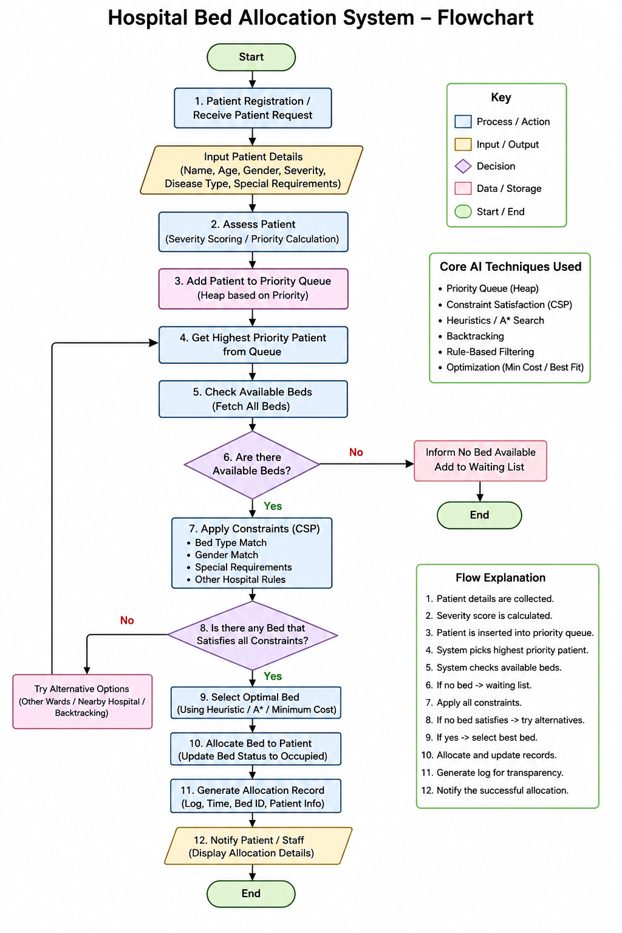

Slide 7
